Slide 1
3D Printing of Spherical Harmonic Manipulatives for the Classroom
Josh Grossman Abigail Taylor ‘13

Slide 2
3D printing
a.k.a. additive manufacturing
build up material
computer file (STL)
3D object
Types:
Extrusion
Binding granular material
Lamination
Light polymerization

Slide 3
3D printing
Initiated in 1980’s
Research → industry → DIY
Exponential price drop
Recently, rapid progress in capability
materials, resolution, speed, …
Rapidly expanding market
Used for prototyping and distributed manufacturing
Compare: home/office publishing (2D printing)
with resources of Internet

Slide 4
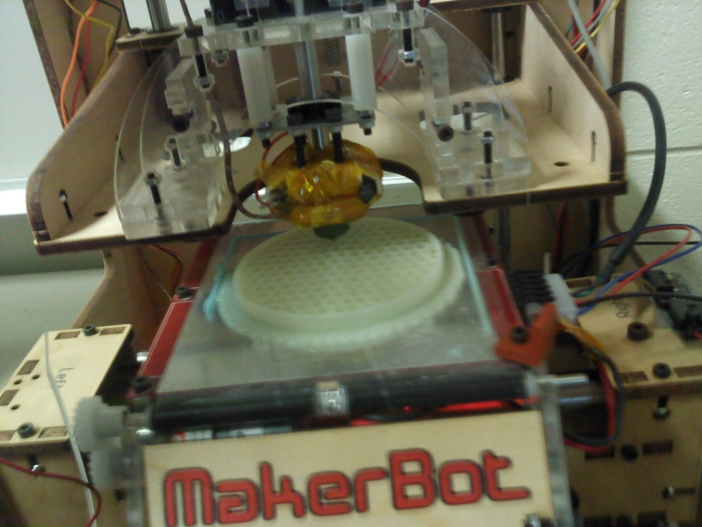
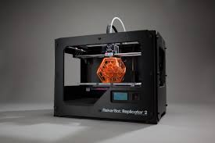
Printer #1: MakerBot Replicator
Extrusion: fused deposition modeling (FDM)
In-house; inexpensive
Thanks to Alan Jamieson,
SMCM Comp Science

Slide 5
Printer #2: Shapeways service
Bound granular material: selective laser sintering (SLS)
Other materials & methods available
Upload file, make payment, receive objects in mail
Better resolution than MakerBot Replicator
Much higher marginal cost per item, but don’t have to buy printer
Marketplace uploading and purchasing designs
SMCM MakerBot printer broke during project

Slide 6
Example project: manipulatives of spherical harmonics

Slide 7
Spherical Harmonics
Angular solutions to Laplace’s equation
Specified by l, m
l = 0, 1, 2, … and m = -l, …, l
Associated Legendre polynomials
Legendre polynomials

Slide 8
Spherical Harmonics
Often initially confusing to students
Geometric properties not immediately evident

Slide 9
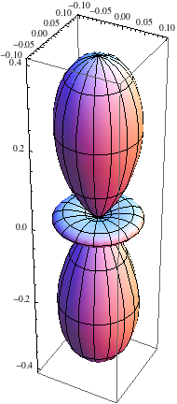
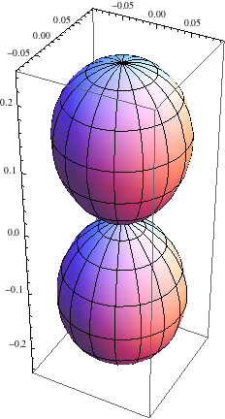
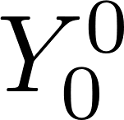
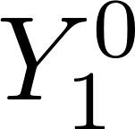
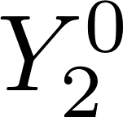
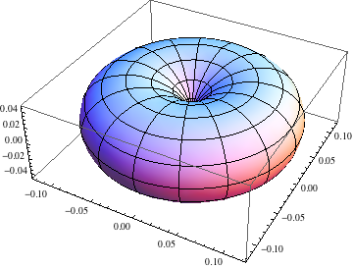
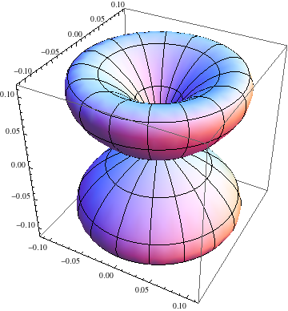
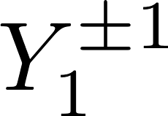
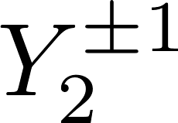
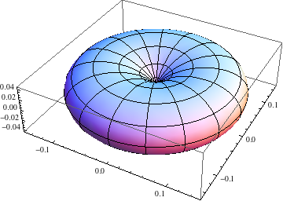
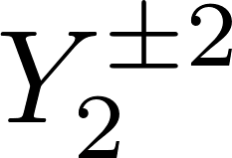
Spherical Harmonics

Slide 10
Process
Equations
Export["00441.STL",
RegionPlot3D[315*Abs[SphericalHarmonicY[0,0,ArcCos[z/(x^2+y^2+z^2)^(1/2)],ArcTan[y/x]]^2]<(x^2+y^2+z^2)^(1/2)<315*Abs[SphericalHarmonicY[0,0,ArcCos[z/(x^2+y^2+z^2)^(1/2)],ArcTan[y/x]]^2]+1.1,{x,-45,45},{y,-45,45},{z,-45,45},PlotPoints->150]]
Mathematica
STL file
Additional processing
(optional)
e.g. ReplicatorG
for MakerBot
Software converts for printing
Finishing
(optional)
Print

Slide 11
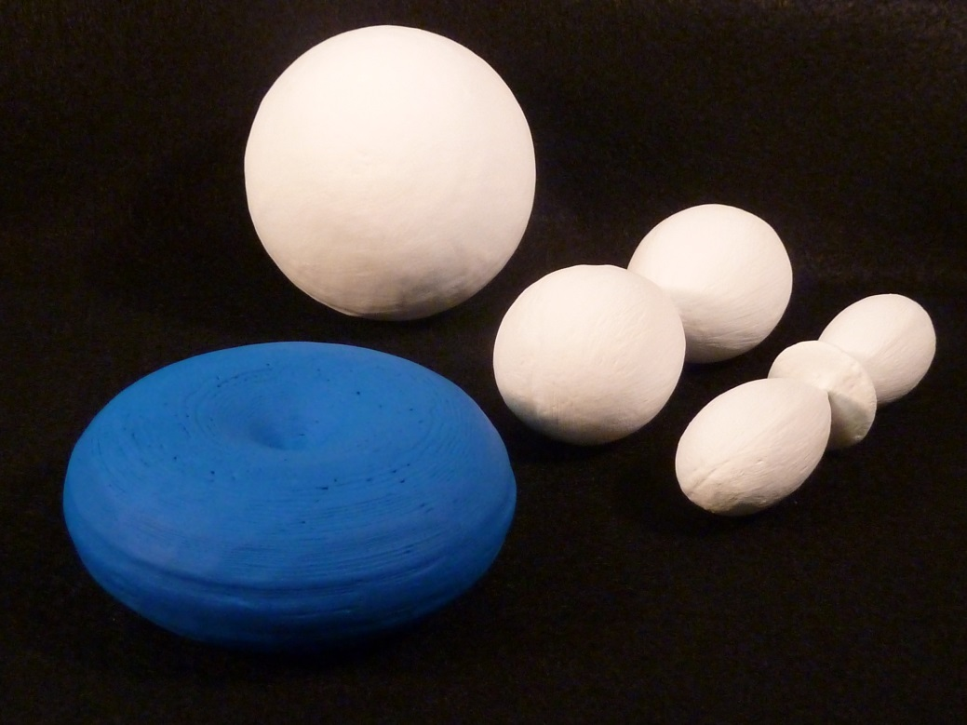
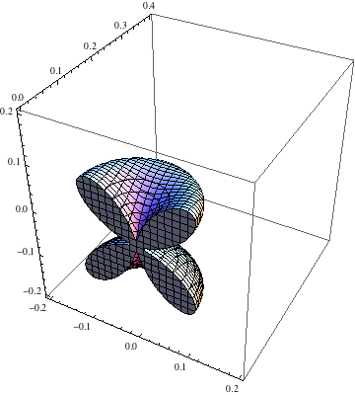
MakerBot models
~$1 each
Honeycomb for solid interiors
Overhangs problematic → print ½’s or ¼’s, then glue
Zero thickness at origin →
Individual plastic strands apparent → sand and paint

Slide 12
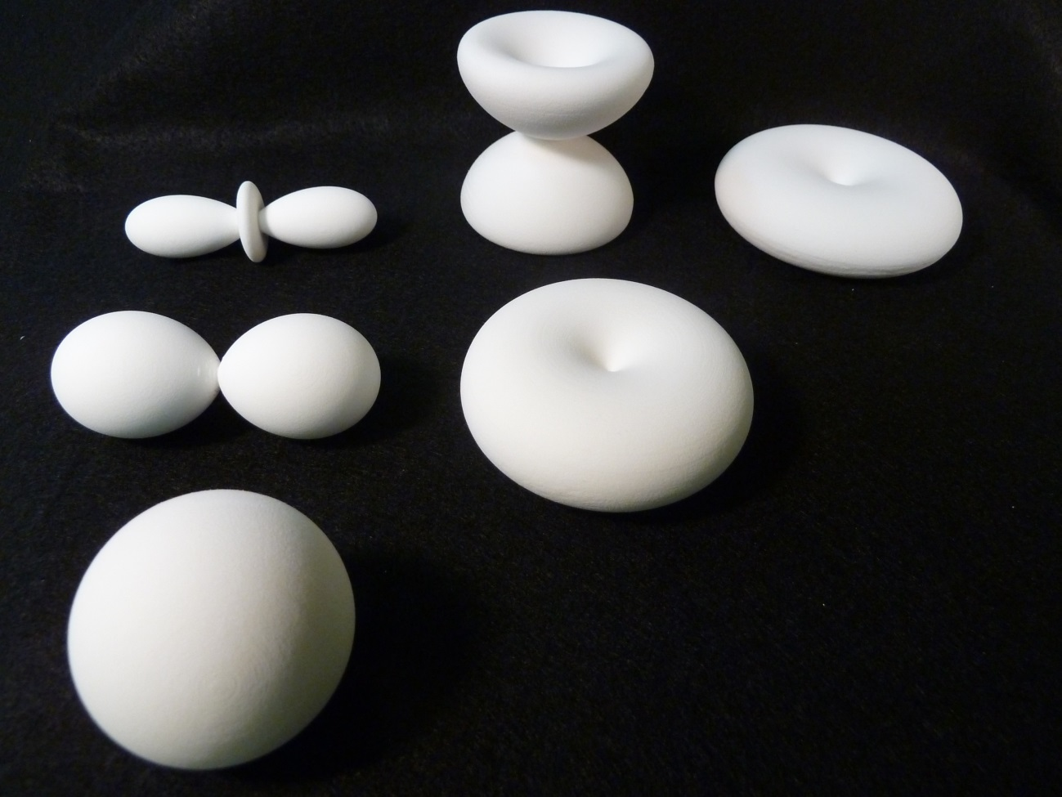
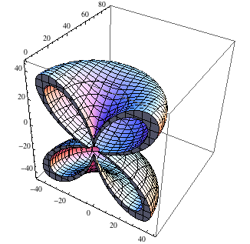
Shapeways models
$15-$45 each
Add thickness

Slide 13
Uses
Spherical harmonic manipulatives used in Quantum Mechanics class and Atomic Physics study group
Illustrated geometric features
Prompted student discussion

Slide 14
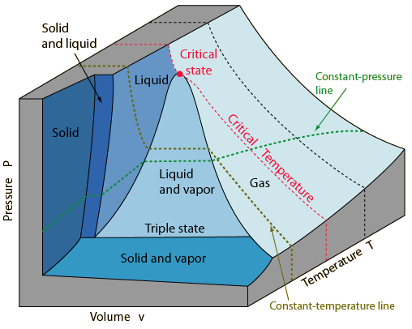
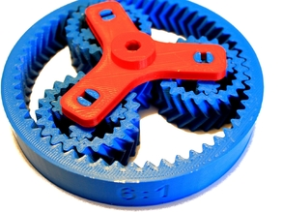
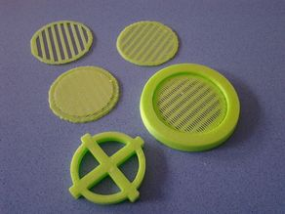
What’s next?
Models of other 3D mathematical abstractions
PvT phase surfaces for Thermodynamics classes, …
Real objects for experiments
Gears, wheels, moment of inertia test objects, …
What would you do?
diagram from Hyperphysics
Fluid filters by user siderits on Thingiverse
http://faculty.smcm.edu/jmgrossman/research/ed/3Dprinting.html
By user ngoodger on Thingiverse

