Slide 1
Operations Research
IT’s the final lecture! (sing it, you know you want to)

Slide 2
5 Problems
Shortest-path problem
Minimum spanning tree problem
Maximum flow problem
Minimum cost flow problem
CPM method of time-cost trade-offs (riveting…)

Slide 3
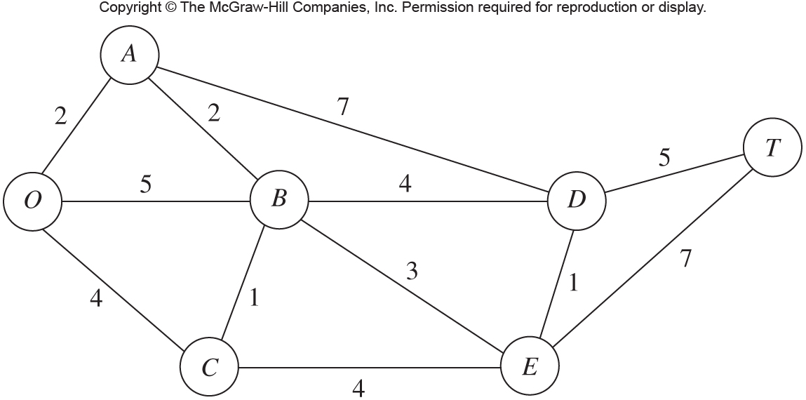
Example
Seervada Park has recently been set aside for a limited amount of sightseeing and backpack hiking. Cars are not allowed into the park, but there is a narrow, winding road system for trams and for jeeps driven by the park rangers. This road system is shown (without curves) below, where location O is the entrance to the park. The numbers give the distance in miles from one point to the next.
The park contains a scenic wonder at station T. A small number of trams are used to transport sightseers from the park entrance to station T and back.

Slide 4
Problem 1
Determine which route from the park entrance to station T has the smallest total distance for the operation of the trams.

Slide 5
Problem 2
Telephone lines must be installed under the roads to establish communication amongst all of the stations with the minimum amount of wire (in miles).

Slide 6
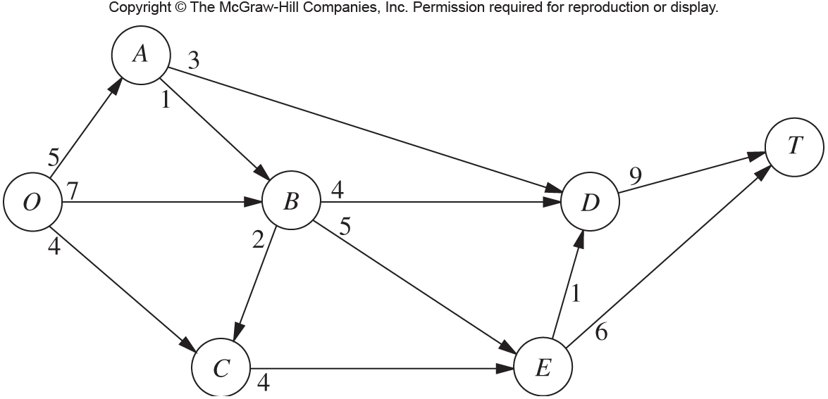
Problem 3
More people want to take the tram ride than can be handled during the peak season. To avoid unduly disturbing the ecology and wildlife of the region, a strict ration has been placed on the number of tram trips that can be made on each of the roads per day. Therefore, during peak season, various routes might be followed regardless of distance to increase the number of tram trips that can be made each day, without violating the limits on any individual road.

Slide 7
Basic Terminology
Nodes, points, vertices / Edges, lines, links, arcs
Directed vs. undirected
Flow
Path and cycle
Connected, spanning tree
Supply, source / Demand, sink

Slide 8
Shortest-Path Algorithm
For this we will utilize Dijkstra’s Algorithm (find the shortest distance from the source to every other node):
1.) Assign every node an initial value – 0 for the source node, M for every other.
2.) Mark all nodes as unvisited. Set the source node as “current”.
3.) For the current node, set the value of all of its neighbors as follows – Neighbor i new value = current node value + weight on edge between current and i – but only if this value is smaller than i’s old value.
4.) Once all of the current nodes neighbors have been processed (#3), mark the current node as visited. If the current node was the destination node, stop here. Otherwise, make the unvisited node that has the smallest value “current” and go back to #3.

Slide 9
Example

Slide 10
Minimum Spanning Tree Algorithm
Target: create a tree that connects all nodes with the minimum cost.
1.) Select any node arbitrarily, then connect it to the nearest distinct node (by weight).
2.) Identify the unconnected node that is closest to a connected node, and then connect these two nodes. Repeat until all nodes have been connected.
3.) Tie breaking – ties for nearest distinct node or closest unconnected node may be broken arbitrarily.

Slide 11
Example

Slide 12
Maximum Flow
Target: find the maximum capacity of a network (from one source to one sink) given some information about capacities along arcs.

Slide 13
Max Flow Algorithm
1.) Identifying an augmenting path by finding some directed path from the source to the sink in the residual network such that every edge on the path has strictly positive residual capacity. If none exists, the net flows assigned are already optimal.
2.) Identify the residual capacity of this augmenting path by finding the minimum of the residual capacities of the edges. Increase the flow in this path by this number.
3.) Decrease the residual capacities along this path by the number found in 2. Return to step 1.

Slide 14
Example

Slide 15
Two Final Problems to Discuss
Minimum Cost Flow Problem: Basically, the same as the max flow problem, but adding in the additional caveat that we have to take into account a cost per unit across an edge. Solved via Network Simplex.
Time-Cost Trade-Off: Scheduling a group of activities based on time and dependencies. The dependencies are modeled as a graph. Solved via CPM method or PERT.

Slide 16
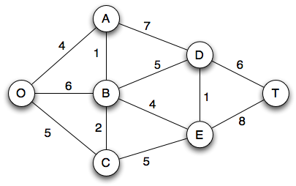
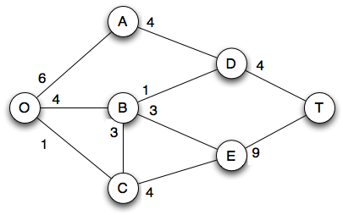
Exercise!

