Slide 1
Operations Research
Assignment Problem

Slide 2
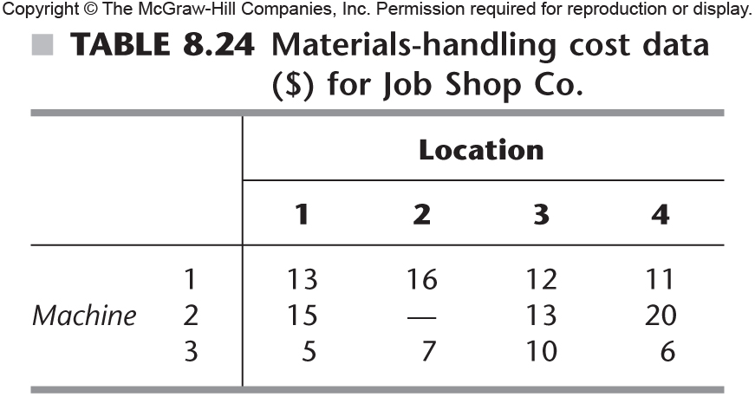

Slide 3
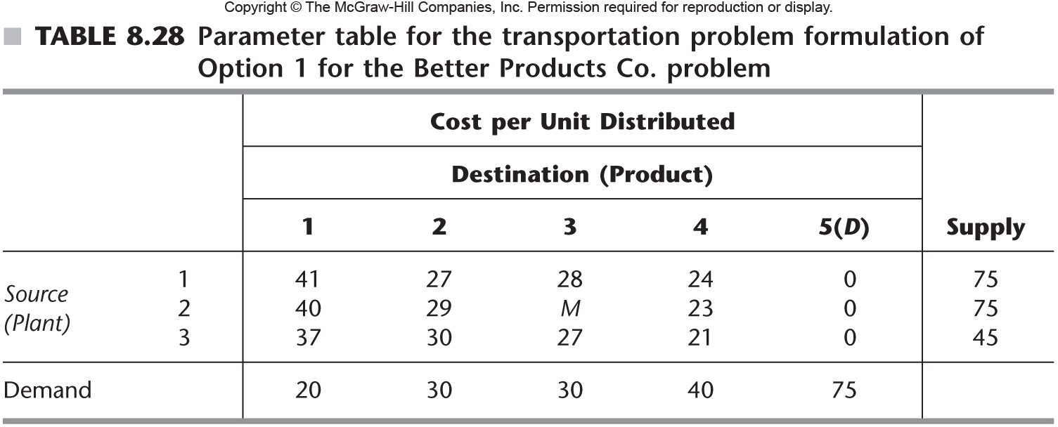
Hungarian Method
Step 0 – get the problem formulated correctly (cost table). For our example problem we need to do two sets of tables, one for option 1, one for option 2. Here’s the table for option 1:

Slide 4
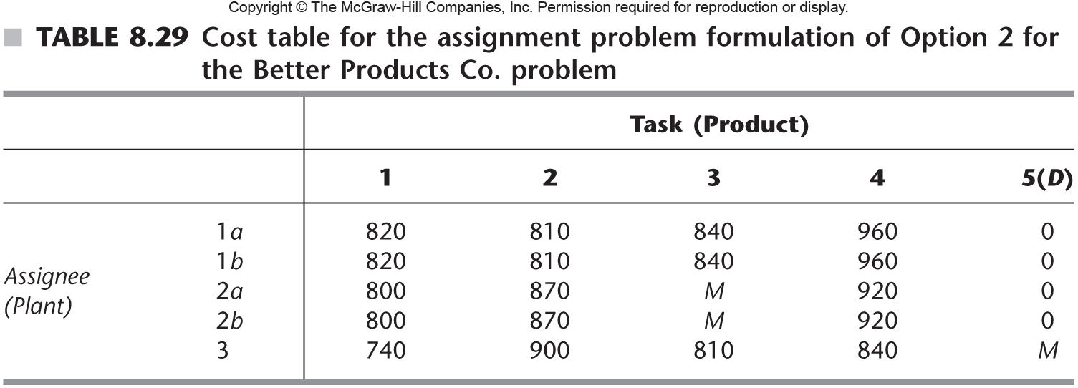
Hungarian Method

Slide 5
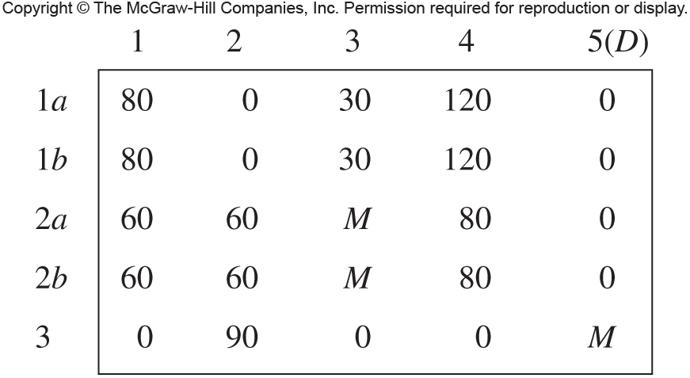
Hungarian Method
Step 1: Subtract the smallest number in each row from every number in the row. Do the same for the columns:

Slide 6
Hungarian Method
Step 2: Check for optimality – can we “cover” all of the zeros by a number of lines equal to the number of assignments that need to be made. Here, we have five assignments that need to be made:

Slide 7
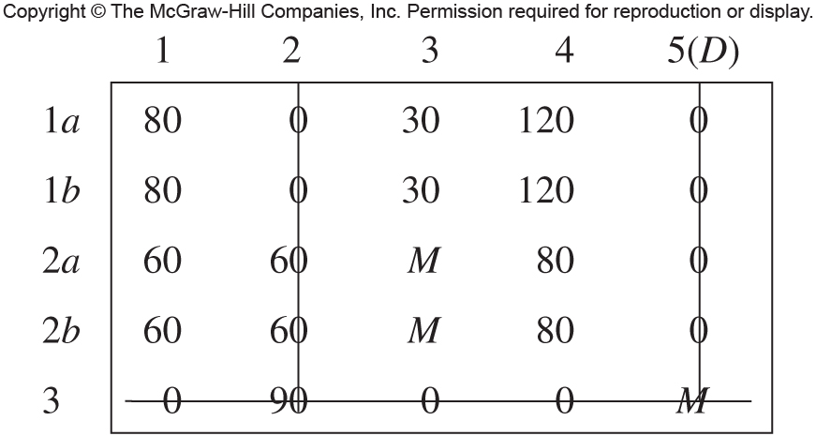
Hungarian Method
Step 3 – Create additional zero elements if necessary! If the minimum number of lines required is less than the number of assignments required, this step will be necessary. Cross out 0’s with the minimum number of lines like so:

Slide 8
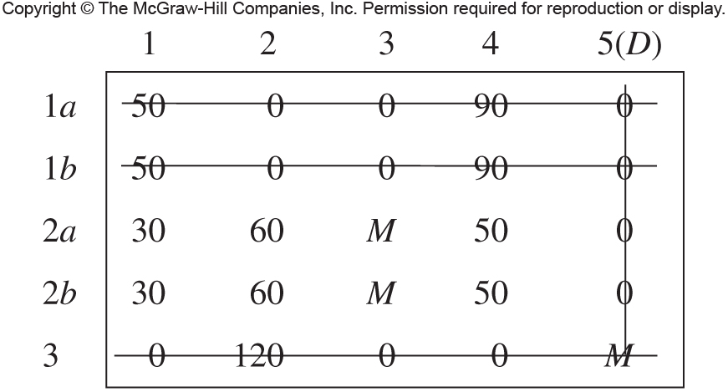
Hungarian Method
Step 3, continued: Then, subtract the smallest value not crossed out from every element not crossed out. Repeat until we have everything crossed out again:

Slide 9
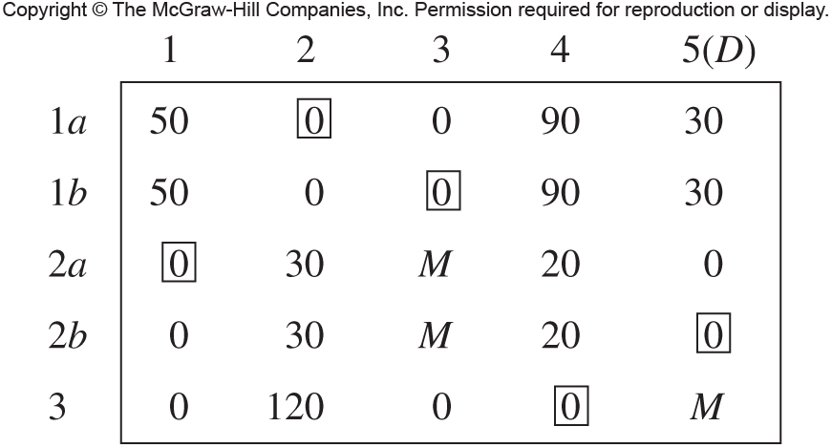
Hungarian Method
Step 3, continued: Then, subtract the smallest value not crossed out from every element not crossed out. Repeat until we have everything crossed out again:

Slide 10
Hungarian Method
Step 4 – Optimal Solution! The boxes represent the optimal assignments:

Slide 11
Now You!
Here’s a cost table – manually solve via Hungarian Method:
 | Job
 | 1 | 2 | 3
Person 1 | M | 8 | 7
Person 2 | 7 | 6 | 4
Person 3(D) | 0 | 0 | 0

