Slide 1
Operations Research
Lecture 6

Slide 2
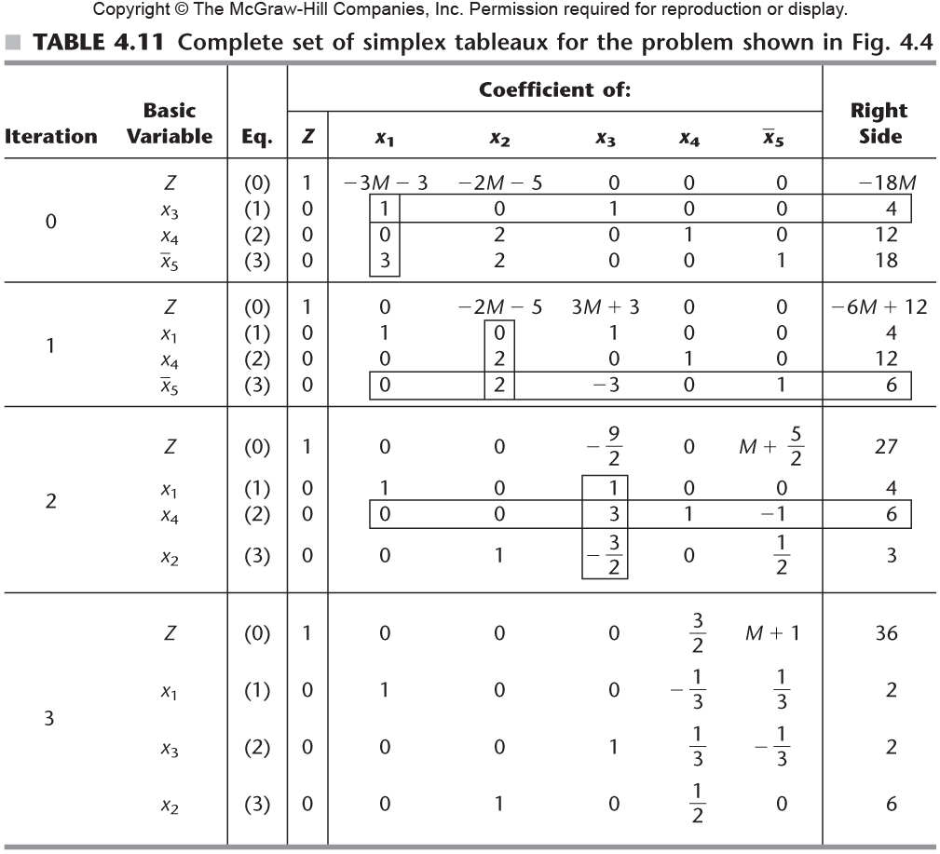
Table 4.11

